Slide 1


Personal Portfolio
-
Project
-
Presentation 2025
Project Presentation
STUDENT NAME: MOHAMMED FAIZ P
REGISTER NO: 31924U18011
NMID: CAC4AFC55DA9F54B8404A13E0344EFF5
DEPARTMENT: DEPARTMENT OF COMPUTER SCIENCE / 2ND YEAR
COLLEGE: MAZHARUL ULOOM COLLEGE/ THIRUVALLUVAR UNIVERSITY

Slide 2
PROJECT TITLE :
Front-End Dev Portfolio
-
01

Slide 3
AGENDA
5. Portfolio design and Layout
01. Problem Statement
6. Features and Functionality
02 Project Overview
07. Results and Screenshots
02.
03 End Users
08. Conclusion
02
03.
04. Tools and Technologies
09 . Github Link

Slide 4
PROBLEM STATEMENT
Presentation
The Need for a Dynamic Professional Showcase
In today's competitive IT industry, a standard text-based resume is often not enough to demonstrate practical skills.
Aspiring developers lack a single, interactive platform to showcase their projects, skills, and experience to recruiters and potential clients.
There is a need for a professional, visually engaging, and responsive personal website that can serve as a comprehensive digital portfolio.
-
03
Personal Portfolio

Slide 5

04
PROJECT OVERVIEW
01
03
The project is a modern, fully responsive personal portfolio website. Its primary goal is to create a visually engaging and professional online presence to effectively showcase your skills, projects, and experience to potential recruiters, clients, and collaborators.
It is built with fundamental web technologies including semantic HTML5, modern CSS3 (using Flexbox and Grid for layout), and JavaScript for interactivity. The project also leverages libraries like AOS for scroll animations and SwiperJS for a responsive testimonial slider.
02
04
The portfolio is rich with dynamic features, including an animated typing effect, a user-selectable dark/light mode, a filterable project gallery with flip animations, and animated skill bars that fill on scroll to create an engaging user experience.
The design prioritizes a clean UI/UX with intuitive navigation and a consistent personal brand. It is fully responsive, using media queries to ensure a seamless and accessible experience across all devices, from desktops to smartphones.
The Goals
Personal Portfolio
-
Project
-
Presentation

Slide 6
WHO ARE THE END USERS AND WHY ?
Academic Reviewers: First and foremost, this project is for my instructors and the Naan Mudhalvan program reviewers who are assessing the web development skills I've learned in this course.
Future Employers: I designed this portfolio to be a professional showcase for recruiters and hiring managers when I start applying for internships and jobs in the IT field.
Peers & Collaborators: It’s also a way to share my work with fellow students and other developers, opening the door for feedback and potential collaborations.
05

Slide 7
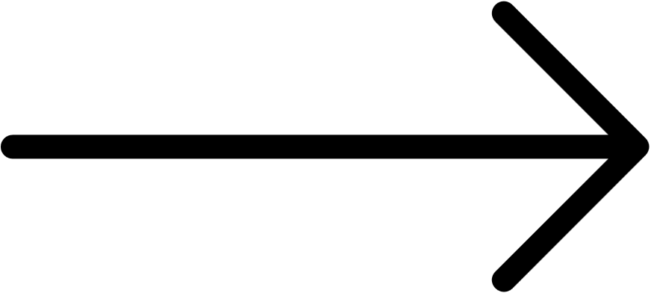
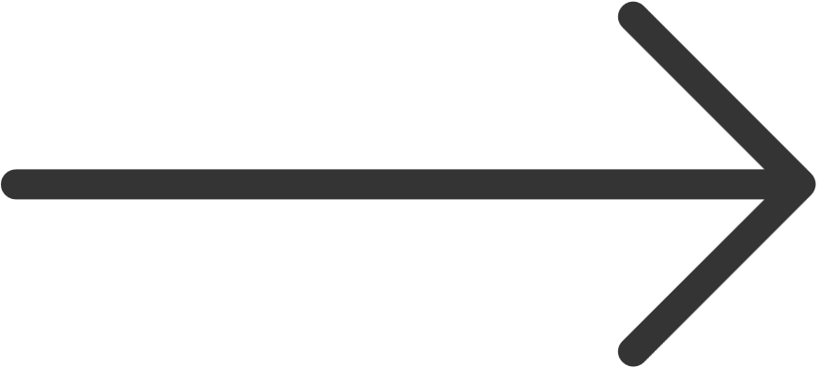
LIBRARIES :
To add professional animations and features, I integrated external libraries like AOS (Animate On Scroll) and SwiperJS. This gave me practical experience in reading documentation .
HTML :
I used HTML5 to structure the content semantically and CSS3 (including Flexbox and Grid) to create a modern, responsive design.
01
04
TOOLS
AND
TECHNIQUES
CSS:
I implemented modern CSS3 layout techniques, specifically Flexbox and Grid. This was essential for creating a fully responsive design that looks great on any device.
GIT & GITHUB :
I used HTML5 to structure I used Git to track changes and GitHub to host my code. This helped me manage my project effectively and allowed me to create a public repository to share my work.
02
05
MASTER OF TOOLS
JavaScript :
I wrote custom JavaScript from scratch to power the interactive features. This included DOM manipulation for the dynamic typing effect and event handling for the filterable project gallery.
DESIGN ASSETS :
To enhance the UI, I used Google Fonts for clean typography and icon libraries like Font Awesome
03
06
06

Slide 8
07
POTFOLIO DESIGN AND LAYOUT
RESPONSIVE DESIGN
CSS GRID
I used CSS Grid to create the website’s main two-column structure. It establishes a fixed column for the profile and a flexible one for content, ensuring a clean and organized layout on desktop screens.
The portfolio uses Media Queries to adapt its layout for different devices. On smaller screens like phones, the two-column grid collapses into a single, stacked column, ensuring the content is always easy to read and navigate.
Design
UX STRUCTURE
DARK/LIGHT MODE
The site is a single page with a logical flow. A sticky navigation sidebar allows users to easily jump between sections without losing their place, creating an intuitive and seamless browsing experience from start to finish.
I implemented a switchable theme using CSS variables for the colors. JavaScript toggles a class to apply the new theme and saves the user's choice in localStorage, so their preference is remembered on future visits.

Slide 9
Animated Typing Effect :
My script uses JavaScript to create a dynamic typing animation, cycling through my different professional roles to engage visitors from the start.
Dark/Light Mode with Memory :
A theme toggle switches between dark and light modes. JavaScript saves the user's choice in localStorage, remembering their preference for their next visit.
01
04
FEATURES
&
FUNCTIONALITY
Smart Navigation Highlighting :
As you scroll, the navigation link for the current section is automatically highlighted, providing clear visual feedback and improving the user experience.
Live Project Filtering:
Users can click filter buttons to instantly sort my projects by category. This provides a fast, seamless way to browse my work.
02
05
Exploring creativity
JavaScript :
I wrote custom JavaScript from scratch to power the interactive features. This included DOM manipulation for the dynamic typing effect and event handling for the filterable project gallery.
Animated Skill Bars :
When you scroll down to my skills, the percentage bars smoothly animate into view, creating a polished and visually appealing effect.
03
06
08

Slide 10
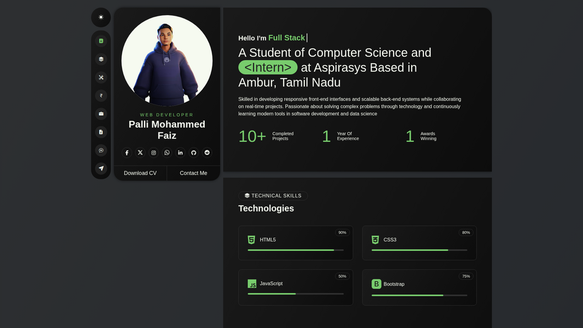
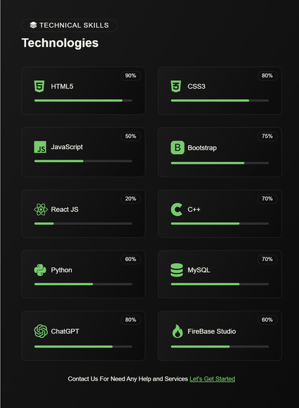
RESULTS & SCREENSHOTS
The final result of this project is a fully functional, responsive, and interactive personal portfolio website. The following screenshots showcase the key features and the polished design of the live application.
WEBSITE SCREENSHOTS :
09

Slide 11
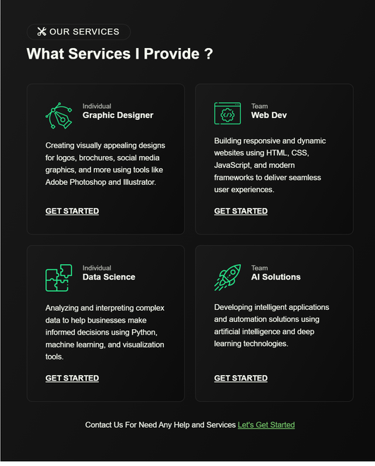
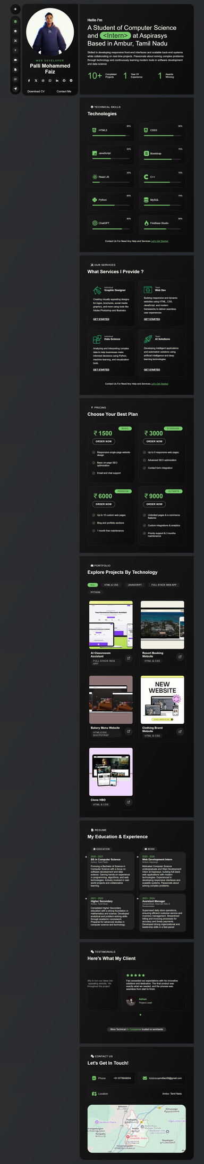
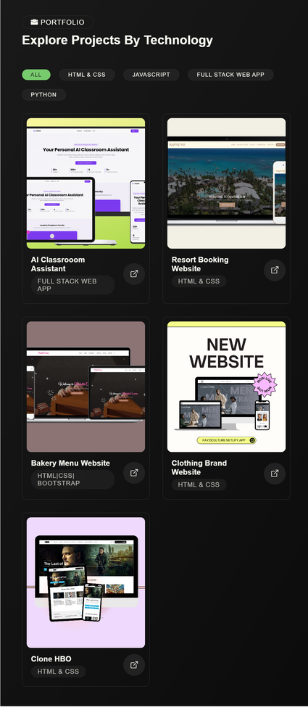
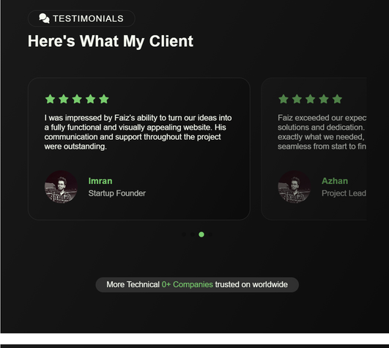
Personal Portfolio
-
Project
10
SCREENSHOTS
A screenshot of the full homepage.
A screenshot showing the filterable project gallery.
A screenshot of the animated skills section.
A screenshot of the website in dark mode.
A screenshot showing how the site looks on a mobile phone to demonstrate responsiveness.

Slide 12
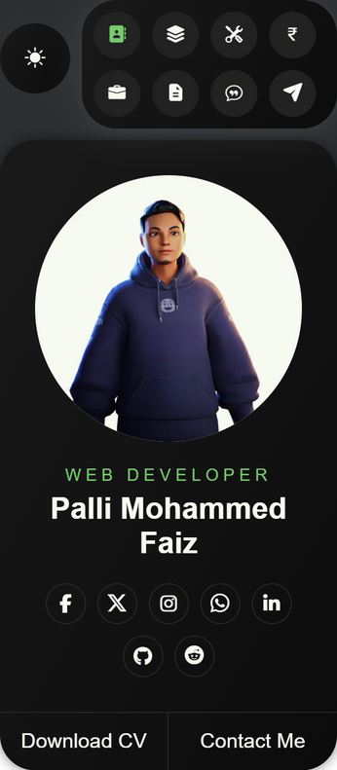
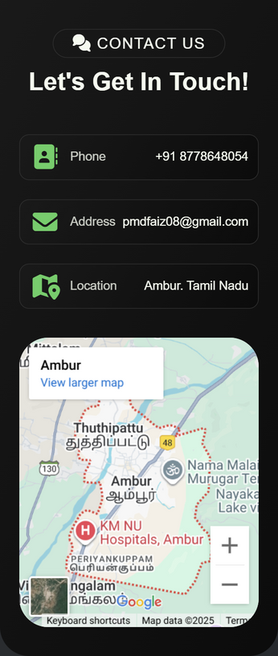
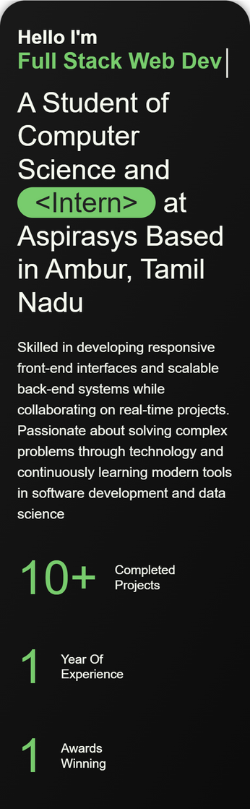
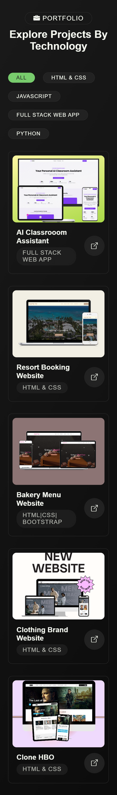
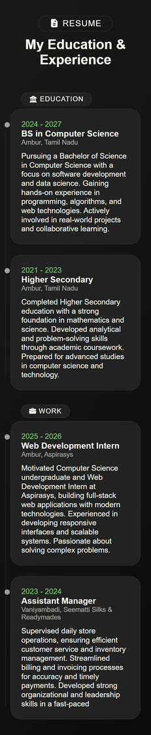
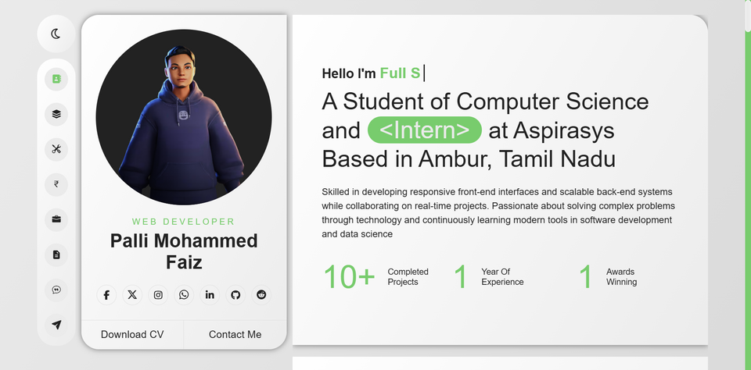
11
SCREENSHOTS
MOBILE :

Slide 13
CONCLUSION :
Successful Outcome : I successfully designed, developed, and deployed a fully responsive and interactive personal portfolio from scratch. The final result is a professional showcase of my abilities in modern web technologies like HTML, CSS, and JavaScript.
Key Learning : Experience Beyond just writing code, this project taught me how to structure a complete web application, implement dynamic features for a great user experience, and ensure the final product is polished and functional across all devices.
Explore the Project The website is live and the complete source code is available for review:
Live Demo: faizwebdev.netlify.app
GitHub Repository: github.com/Faiz-7716/PERSONAL-PORTFOLIO
12

Slide 14
Thynk Unlimited
-
Project
-
Presentation 2024
Thank You
by Mohammed Faiz Palli - 31924U18011
Mazharul Uloom College, Ambur

